Slide 1
Business Process Engineering
Sobia Iftikhar

Slide 2
Content
Business Process Architecture

Slide 3
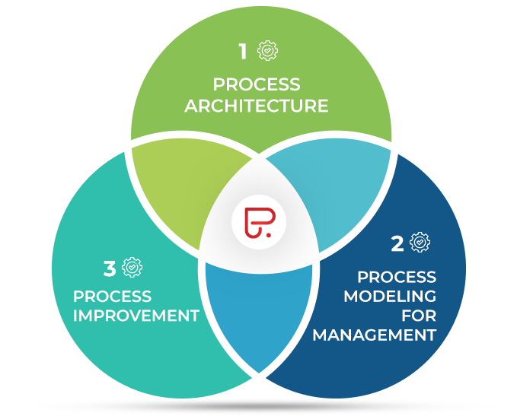
Business Process Management
Process Modeling For Management
Process Improvement
Business Process Architecture

Slide 4
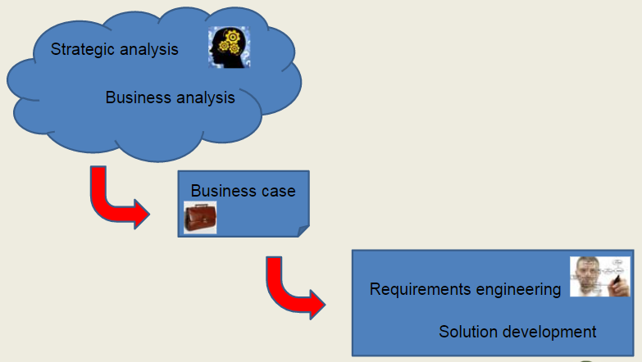
The breath of Business Analysis

Slide 5
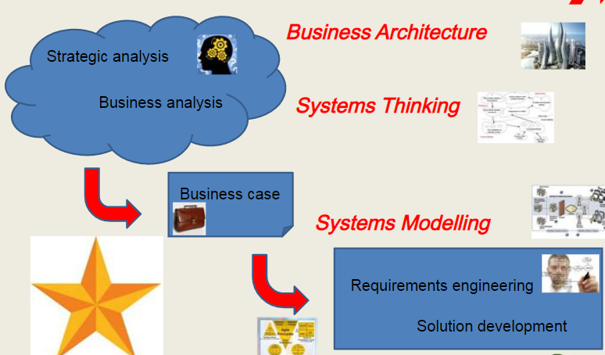
The breath of Business Analysis

Slide 6
Business Process Architecture
A Business Process Architecture is the overview of a set of business processes that reveals their inter-relations
.Every company has a different process architecture that keeps on changing with time.
Process architecture recognizes the important concepts involved in company’s processes

Slide 7
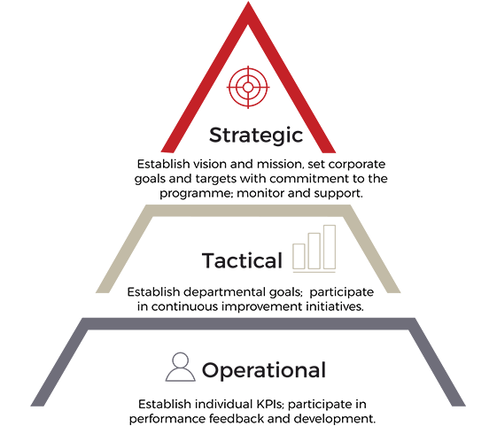
Business Process Architecture
It is a critical business blueprint that guides decision makers in executing strategy. Usually created to include, initially, the two or three highest levels,
Cross-functional business processes are the only way any organization can deliver value to customers and external stakeholders

Slide 8
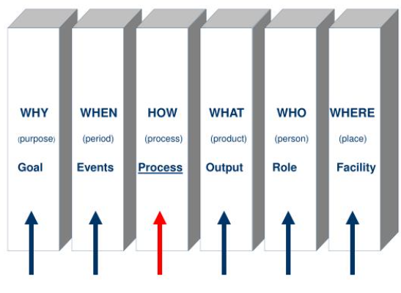
Focus for process

Slide 9
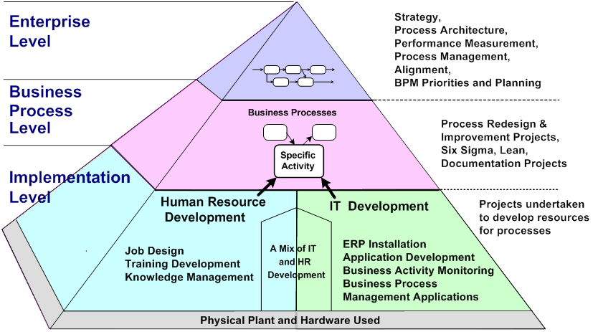
A Business Process Architecture
Connecting Business Strategy to Business Requirement

Slide 10
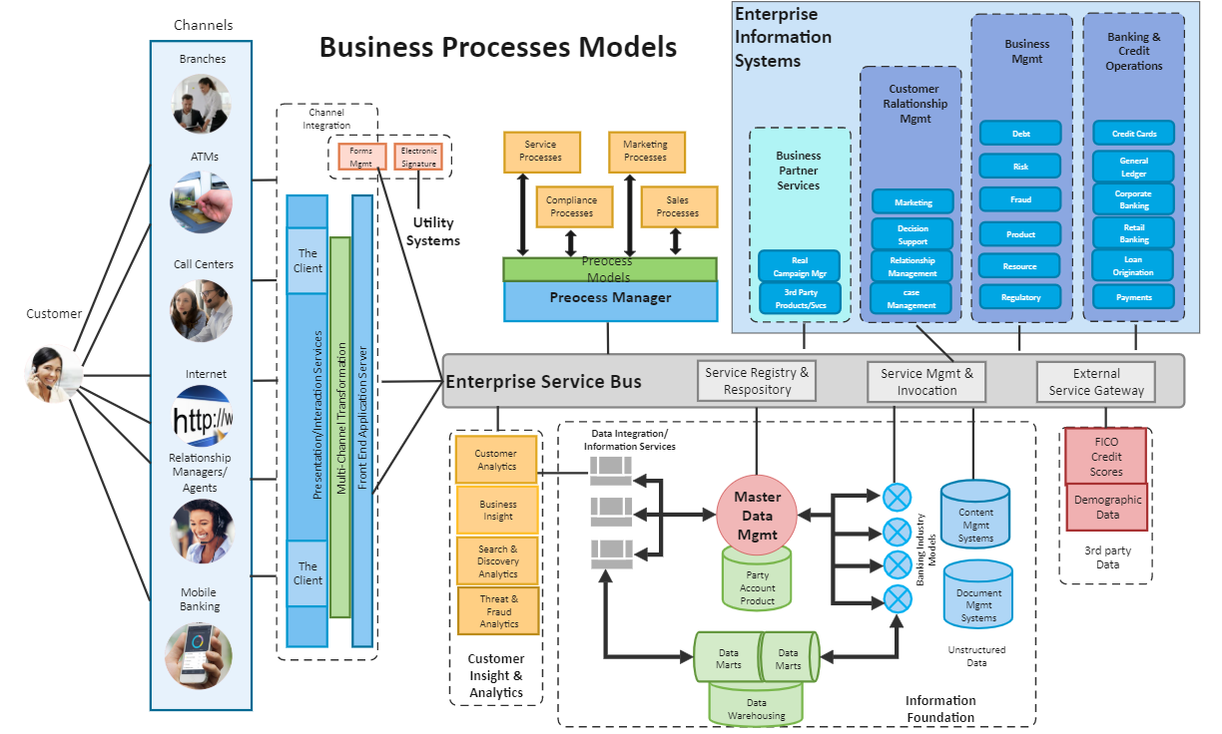

Slide 11
Business Process Architecture Design Models.
There are a number of approaches to design a business process architecture.
On what basis are processes and their relation identified according to this approach?’
This led to five classes of approaches:
goal-based
action-based
object-based
reference model based,
function-based.

Slide 12
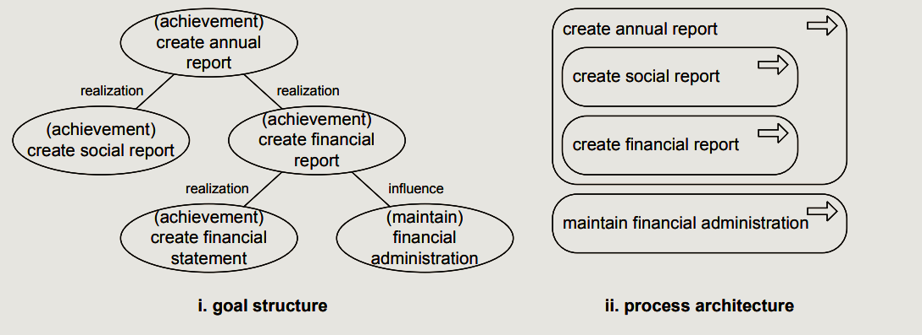
Goal Based
In the Goal-Based Approach, the business architecture is designed to establish essentials of business goals and relationships between business goals.
This approach identifies all critical business processes which are essential to achieve business goals.

Slide 13
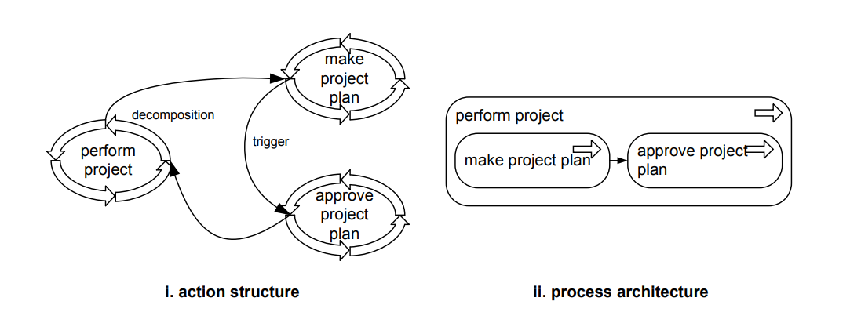
Action Based

Slide 14
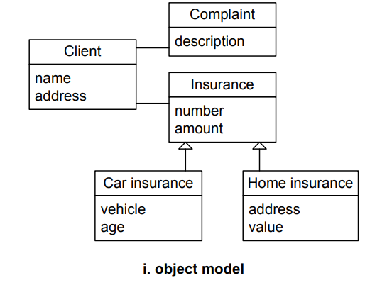
Object Based

Slide 15
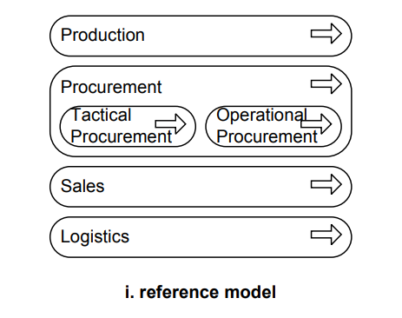
Reference Based
These reference models can be re-used and adapted by the organization, as per their requirement to design their business process architecture.
There are various industry-specific as well as management-related reference models are available. Some of these are APQC process frameworks for specific industries, Malcolm Baldridge Industry-specific Frameworks (like Healthcare, Education, etc), European Framework for Quality Management System (EFQM), or standards like ISO 27001 for Information Security, etc.

Slide 16
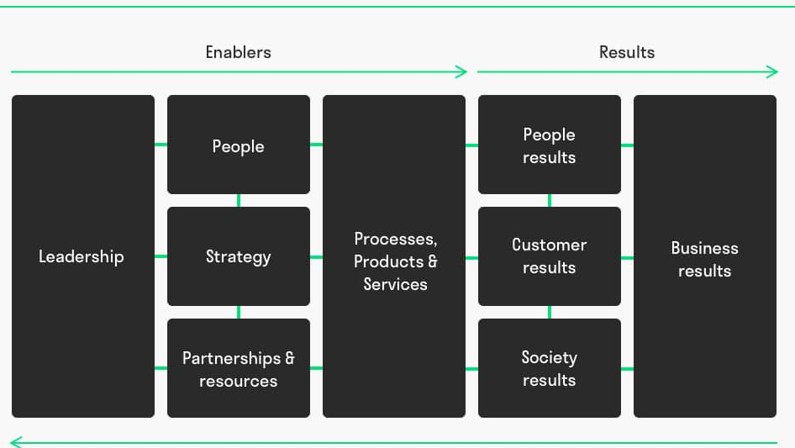
European Framework for Quality Management System (EFQM)
EFQM was founded in 1988 with the objective to create a platform where organizations can learn from each other to continuously improve their performance.
The EFQM Model or EFQM business excellence model is the most popular quality management tool in Europe, used by more than 30.000 organisations to improve performance. It supports you to self-assess and reflect. 84% of our members say that the EFQM model helps to improve their organization.

Slide 17
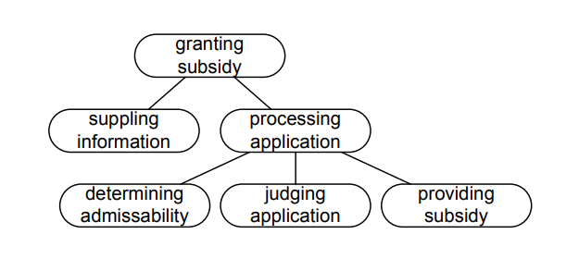
Function Based
It helps to identify “What” are the capabilities of an organization and map it with the business processes.
For Ex: a Production Function can be decomposed into Production Planning, Material Planning and Receipt of Goods, Production Execution, Finished Goods Delivery.
Similarly, Production Planning can be further decomposed into Order Creation, Block Raw Material, Plan Batch Size, etc.
The advantage of this approach is to find the End-to-End value chain associated with a function and assign a process owner along with the process measurement system.

Slide 18
Can we align Business Process Management (BPM) and Business Process Architecture (BPA) together?
Incorporating business process management (BPM) and business process architecture (BPA) together is definitely the way forward.
It can be rightly said that BPA is the one of the cores of BPM.
BPA allows you to manage your processes much more efficiently.
For BPM to work effectively, it needs appropriate and structured methodologies. Business process architecture model provides that structure.

Slide 19
Case study: eTOM
A telecom organization wanted to work closely with another telecom company from a different country. They spent many, many months in talks about how to integrate their respective processes, but all the meetings and efforts were in vain. There seemed to be no progress in coming to a solution; whenever a problem was solved, one or even two additional problems appeared. When we came in, we realized that both organizations had different systems, processes, business and customers, and even a different definition for activities. We used the eTO/M model to come to a common understanding and agreement on the processes and related definitions, which clearly allowed the specification of where the interfaces between both organizations should be. This allowed us to complete the work within weeks, providing a robust and acceptable solution
eTOM (enhanced Telecom Operations Map) is a framework for enterprise processes in the telecommunications industry.

Slide 20
What is process orchestration?
Business Process Orchestration is a methodology to help reduce the amount of time, money, and effort required to complete daily tasks by standardizing processes and introducing automation, validation, workflow, and controls where appropriate

